Slide 1
Artificial Intelligence
in Business and Management
Vladan Devedzic
CIBMEE 2021

Slide 2
Examples of AI in business and management
https://www.nibusinessinfo.co.uk/content/examples-artificial-intelligence-use-business
AI-powered hiring platforms
Humantic AI (and its extensions)
Apploi (specialized in hiring healthcare professionals)
Fortay (user interface details)
for more details see this
"The things that AI is not good at doing is soft skills" (S. Mondal)

Slide 3
Defining human intelligence?
Capability of creating a variety of behaviors,
while complying with the givens of the system/environment
Henrik H. Lund, U. of Southern Denmark

Slide 4
AI, ML, DL
AI
Mimicking the intelligence or behavioral patterns of humans or any other living entity, using logic, rules, ML, DL,...
ML
Using mostly statistical techniques by which computers can "learn" from data (improve at tasks with experience), without using a complex set of different rules. Mainly based on training a model from datasets.
DL
Exposing multilayered neural networks to vast amounts of data in order to train them to perform image recognition, speech recognition and the like.
After https://commons.wikimedia.org/wiki/File:AI-ML-DL.png

Slide 5
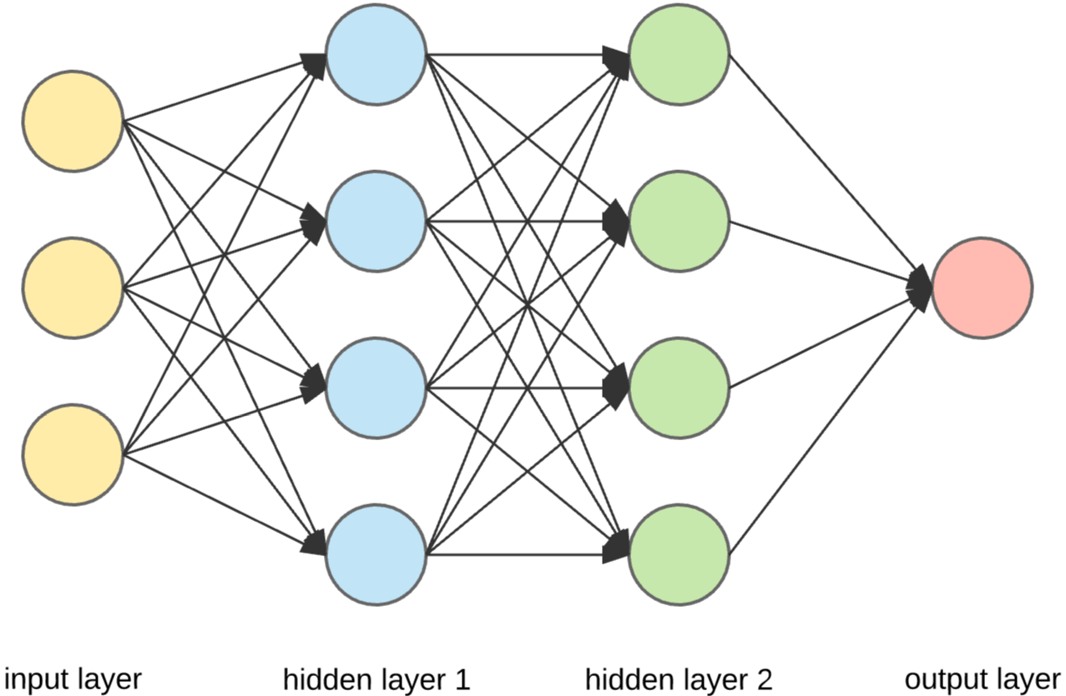
NN, DNN
Source: https://towardsdatascience.com/build-up-a-neural-network-with-python-7faea4561b31

Slide 6
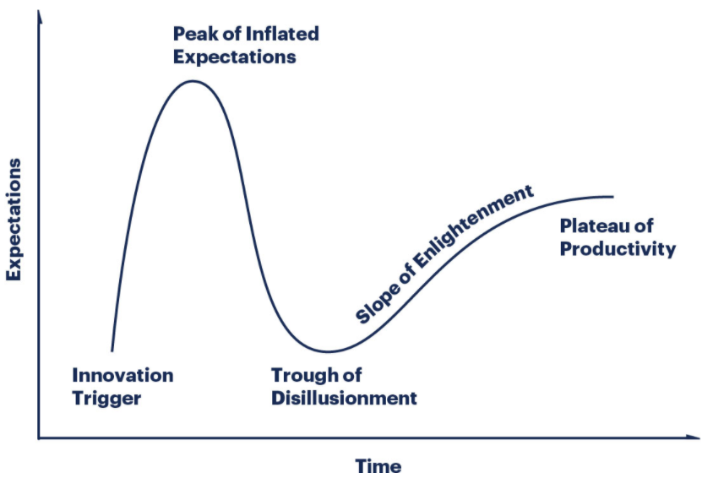
Gartner Hype Cycle
Image source: https://www.gartner.com/en/research/methodologies/gartner-hype-cycle

Slide 7
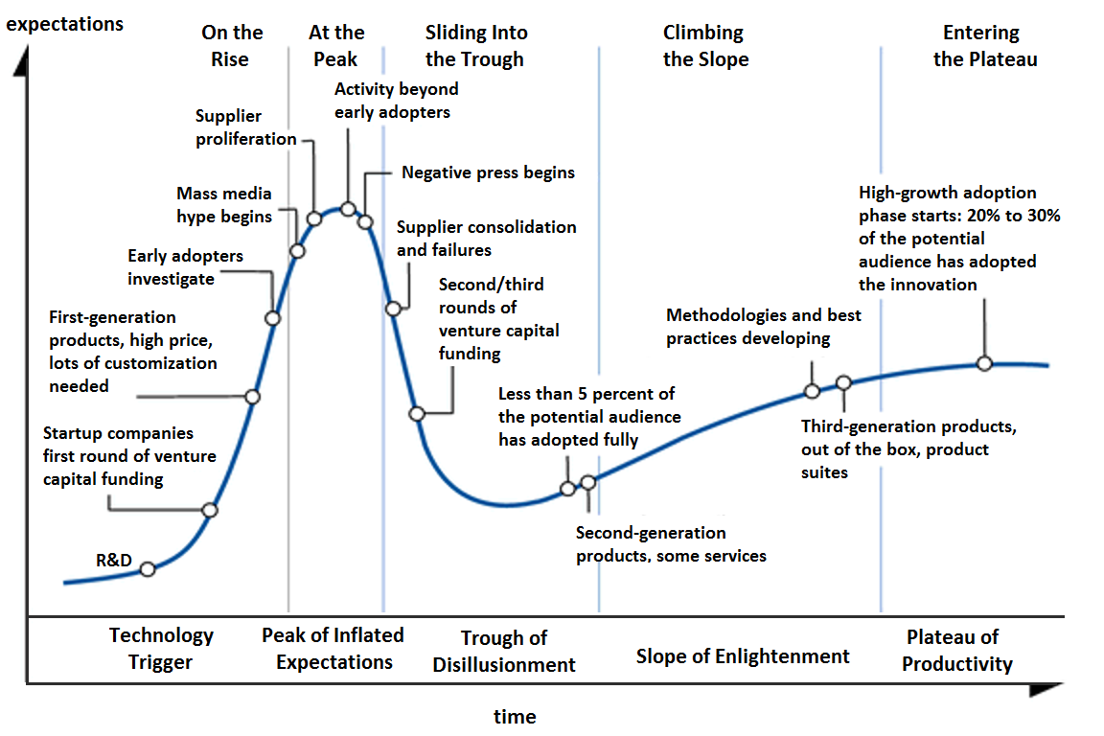
Image source: https://commons.wikimedia.org/wiki/File:Hype-Cycle-General.png

Slide 8
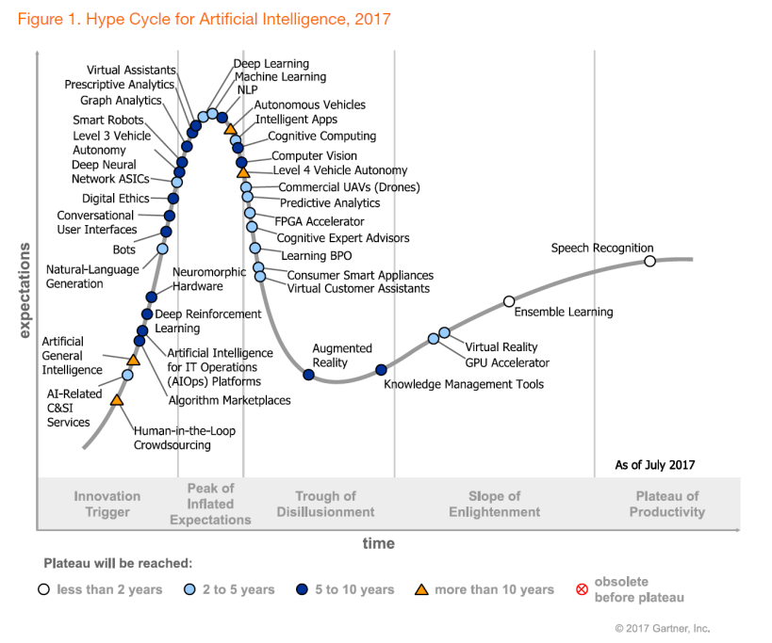
Recent AI trends
Gartner Hype Cycle for
Artificial Intelligence, 2017

Slide 9
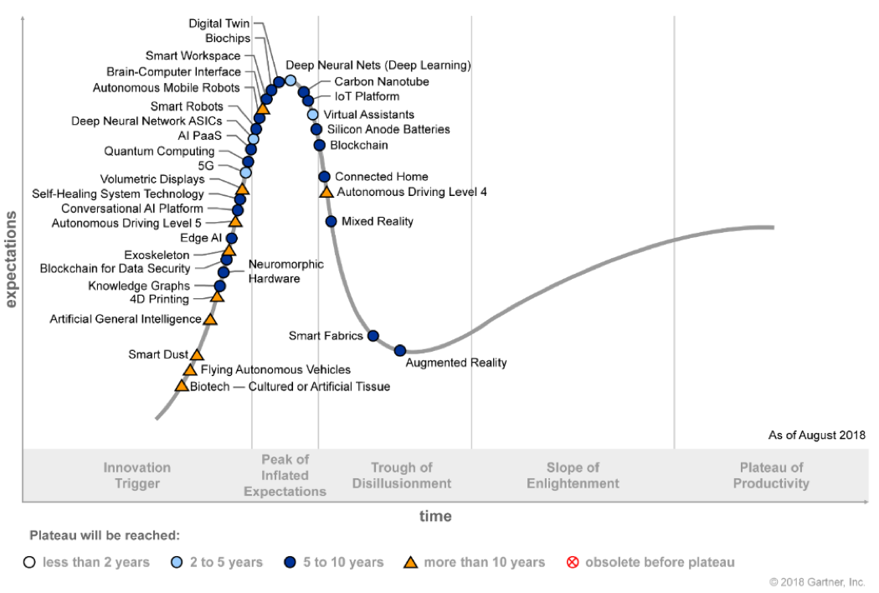
Recent AI trends
Gartner Hype Cycle for
Artificial Intelligence, 2018

Slide 10
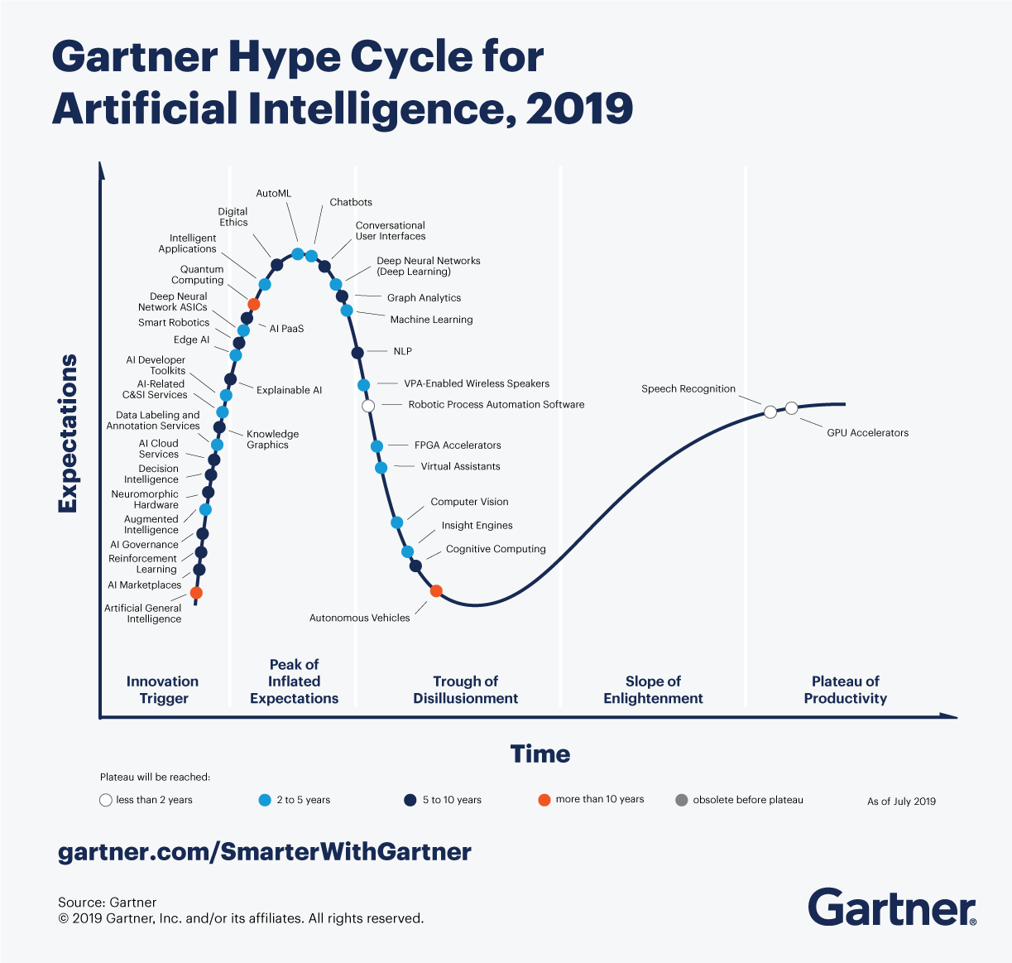
Recent AI trends
Gartner Hype Cycle for
Artificial Intelligence, 2019

Slide 11
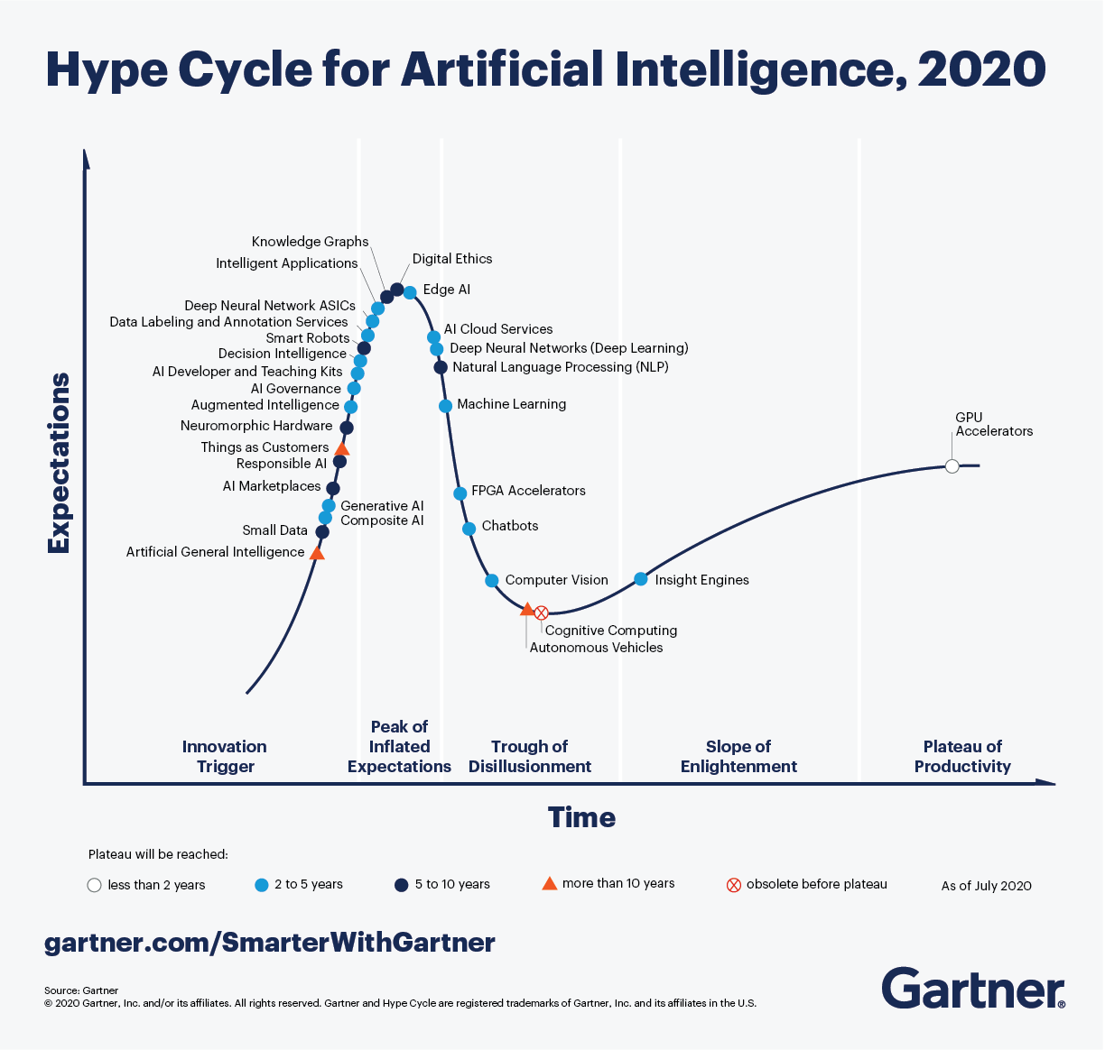
Recent AI trends
Gartner Hype Cycle for
Artificial Intelligence, 2020

Slide 12
AI, business and managers
Human-driven AI vs. autonomous AI
Can robots replace managers ?
Hiring AI experts
ML engineers skills – DBA, SQL, data wrangling, programming, security,...
AI as a marketing term
Model democratization
YAGNI – "You Aren't Gonna Need It" ?

Slide 13
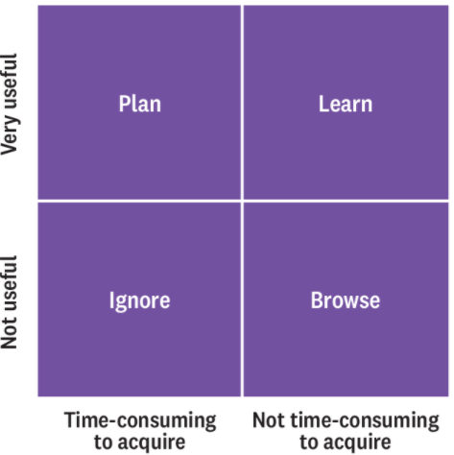
AI, business and managers
Which data skills should you learn first (HBR) ?
AI – ML, DL,...
Data engineering skills – collecting, storing, cleaning… data
Source: https://hbr.org/2018/10/prioritize-which-data-skills-your-company-needs-with-this-2x2-matrix

Slide 14
What they do not tell you...
The fear of missing out
Inferring/Predicting trivial things
Inferring/Predicting non-actionable things

Slide 15
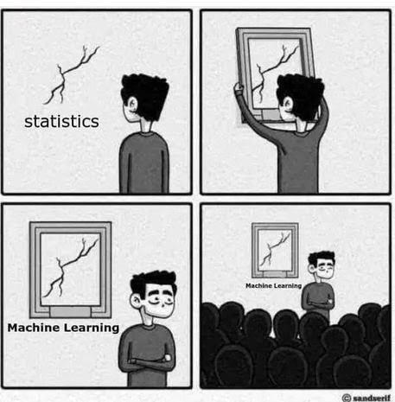
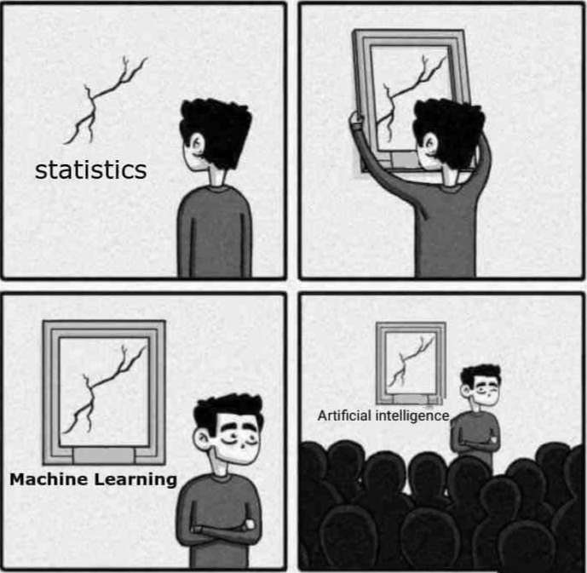
AI or...
Source: https://towardsdatascience.com/no-machine-learning-is-not-just-glorified-statistics-26d3952234e3

Slide 16
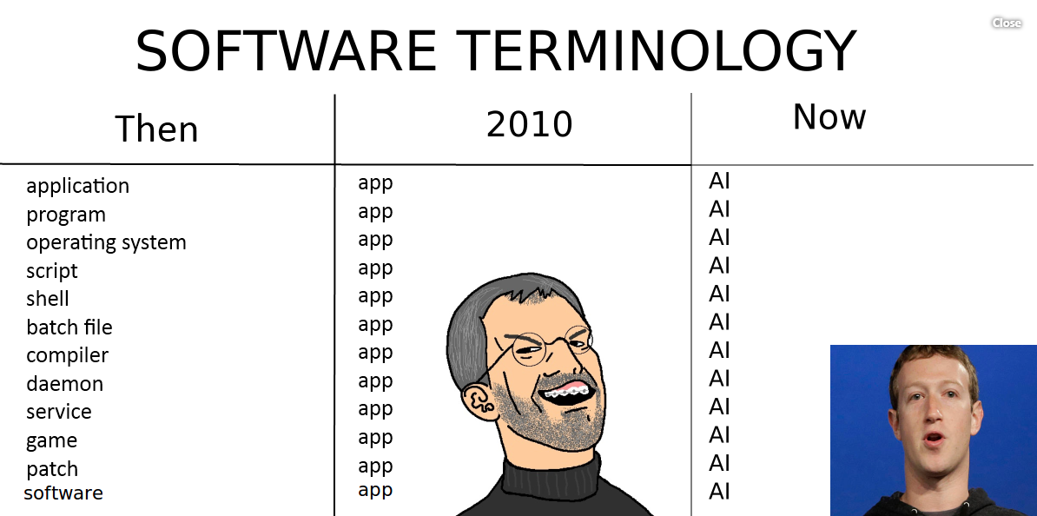
AI or...
Source: http://www.commitstrip.com/en/

Slide 17
AI or...
Source: https://twitter.com/ossia/status/1097804721295773696?lang=en
When you're fundraising, it's AI. When you're hiring, it's ML. When you're implementing, it's logistic regression.
Quincy Larson

